Slide 1
UNDP’s Experiences and Lessons Learned - How can Legislatures Best Support and Promote LGBTI+ Participation?
Workshop D: 67th Commonwealth Parliament Conference
6 November | 14:00 – 16:00
Kathryn Johnson
Policy Specialist, HIV and Health Group | Bangkok Regional Hub

Slide 2
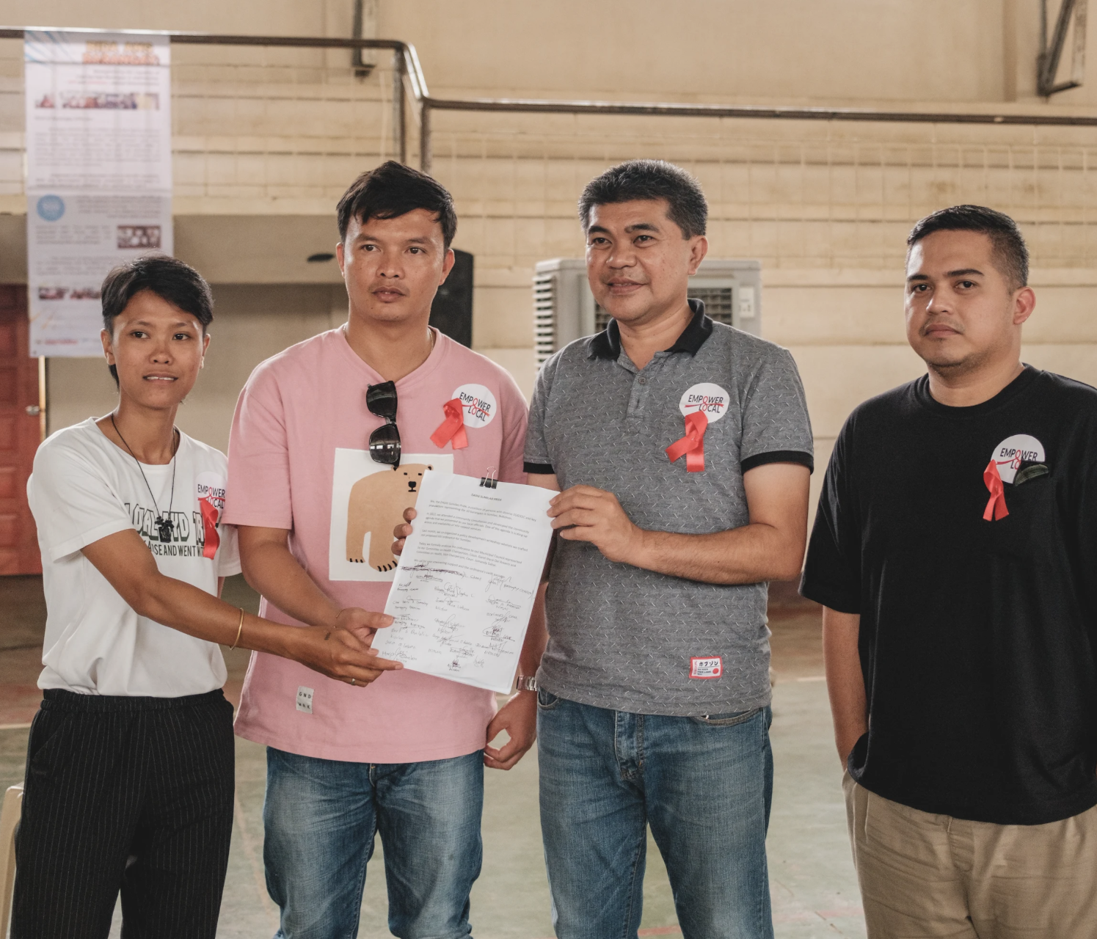
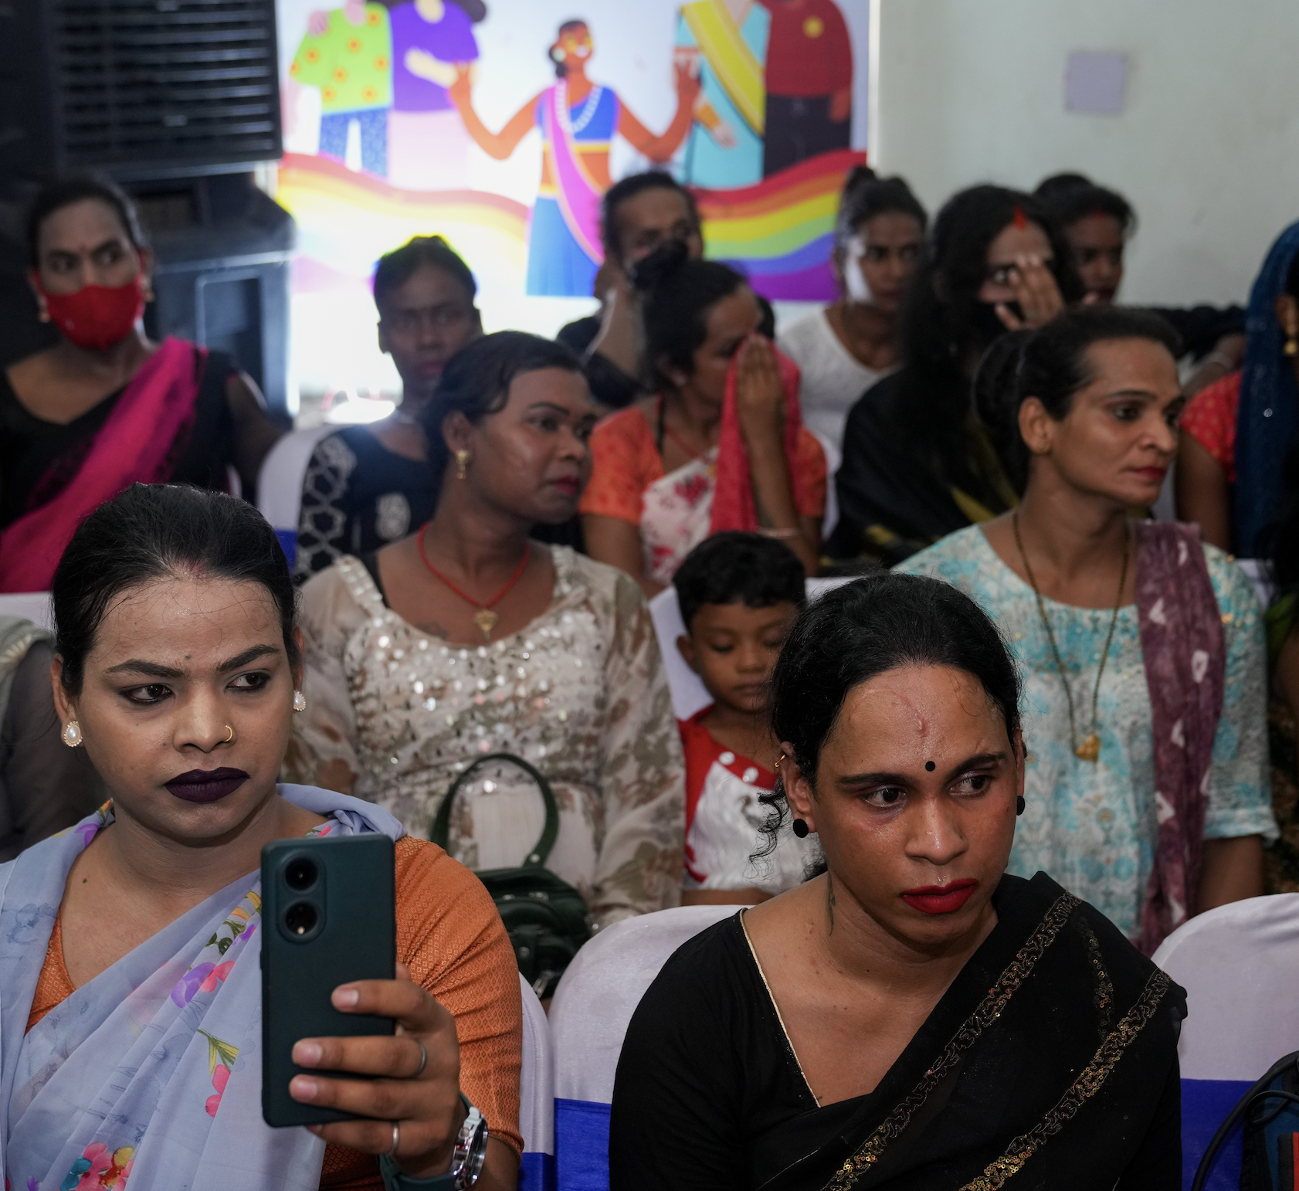
Overview
UNDP’s Commitment
UNDP works in 170 countries to ensure no one is left behind, focusing on inclusivity and equality as fundamental to sustainable development.
Democratic Participation
Ensuring the meaningful engagement and participation of groups facing marginalization or vulnerabilities, particularly LGBTI+ individuals, is essential for strengthening democracies.

Slide 3
UNDP was the first development agency to integrate sexual orientation, gender identity and expression, and sex characteristics in their programming
2007 focus on LGBTI+ intersections with HIV as part of UNDP’s mandate as co-sponsor of UNAIDS
2014 lens of social inclusion and launch of first major LGBTI+ initiative beyond HIV - Being LGBTI in Asia-Pacific
2015-2018 other regional projects launched including Being LGBTI in Eastern Europe, Being LGBTI in the Caribbean and the Africa-focused project on Sexual Orientation and Gender Identities and Rights
2021 #webelongafrica - the Inclusive Governance Initiative and the Southern Africa Young Key Populations Inclusion Initiative
By 2023 UNDP had supported almost 100 countries to include LGBTI+ people and issues in development efforts
Notes:
The most documented interventions are: 1) capacity building of rights holders, 2) building the evidence base through research and documentation 3) training and sensitization of duty bearers 4) access to and provision of legal services 5) establishing and working with coalitions, networks and alliances.

Slide 4
Strategies underlying UNDP’s work on LGBTI+ inclusion:
Six Pathways to LGBTI+ inclusion:
1) Social; 2) Legal; 3) Public-Sector Services; 4) Democracy & Governance; 5) Movement & Leadership; and 6) Knowledge.
Three Core Strategies employed:
Supporting champions within government and state structures (including parliaments and the judiciary)
Strengthening LGBTI+ organizations to influence public policy
Leveraging UNDP’s ability to safely facilitate and convene across government, civil society and the private sector

Slide 5
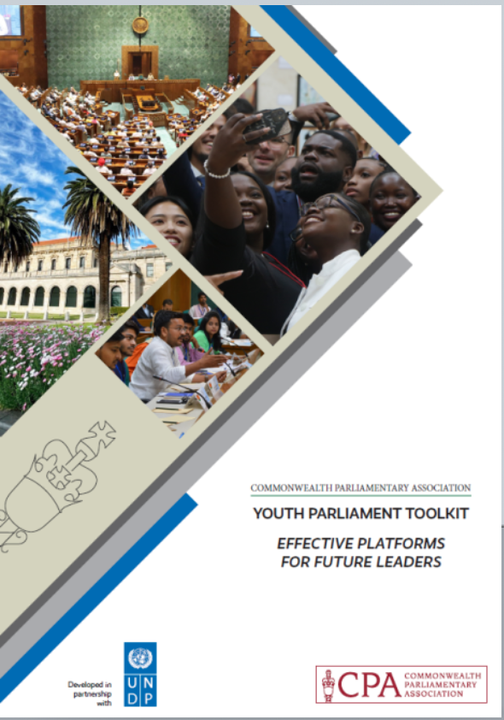
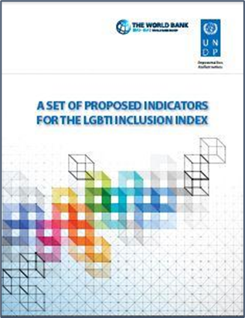
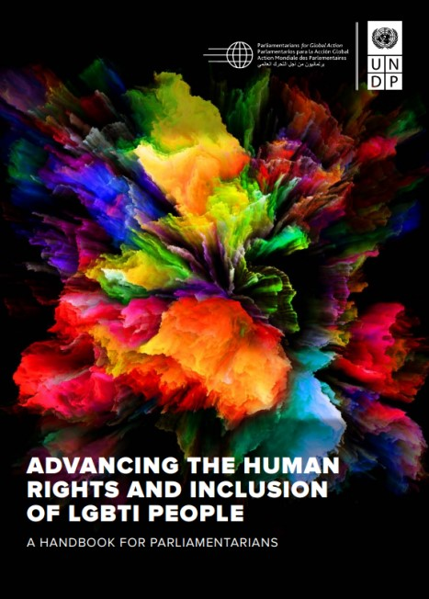
Initiatives are based on robust global research and knowledge products such as:
The LGBTI Inclusion Index which contains 51 indicators which are aligned with the SDG targets’ indicators and draws attention to the need for safe, disaggregated LGBTI data collection to inform inclusive policies and practices in countries around the world.
The Handbook for Parliamentarians on Advancing the Human Rights and Inclusion of LGBTI People, which has been adapted into English, French, Mandarin, Portuguese, Russian, Spanish, Thai, Turkish, and Vietnamese.
The Youth Parliament Toolkit contains expert advice on establishing, planning, running and promoting a Youth Parliament with additional case studies and evaluation methods from across the Commonwealth.

Slide 6
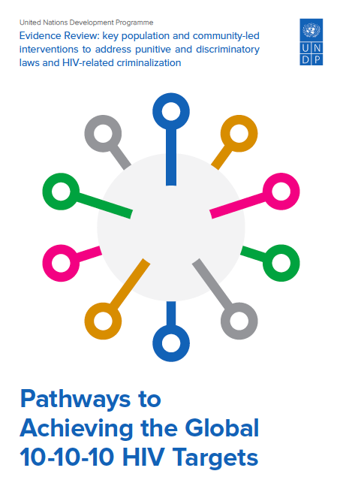
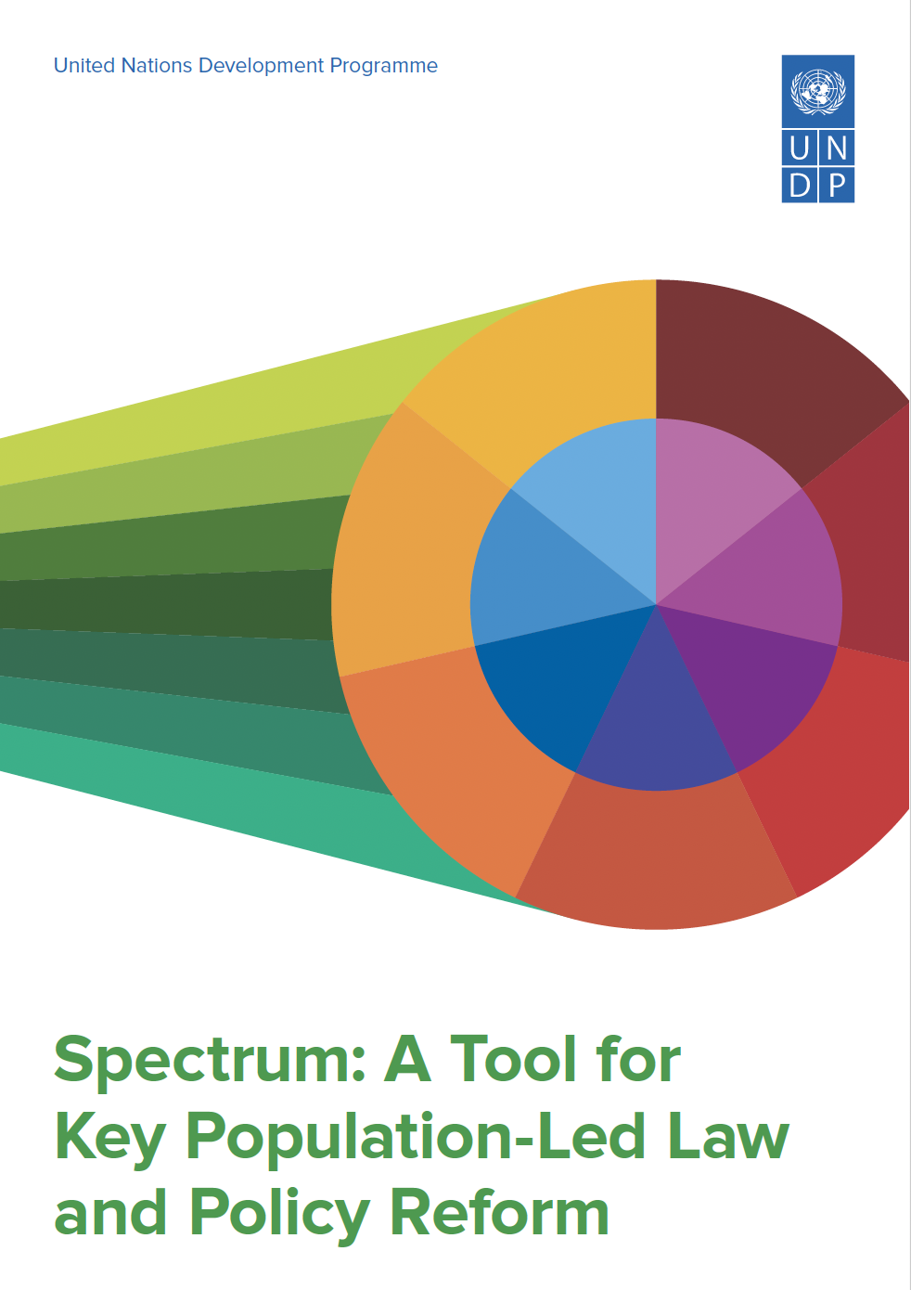
Initiatives are based on robust global research and knowledge products such as:
The landmark 2012 Global Commission on HIV and the Law report presents a coherent and compelling evidence base on human rights and legal issues relating to HIV recommending that governments enact laws based on evidence, human rights and public health.
UNDP-led Pathways to Achieving the Global 10-10-10 HIV Targets review identifies the 14 community-led tactics, strategies and approaches that have been used to remove or mitigate the impact of discriminatory and punitive laws and policies and HIV-related criminalization.
The Spectrum: A Tool for Key Population-Led Law and Policy Reform illustrates how people living with HIV, other key populations and their allies can strategically approach law and policy reform to remove barriers to HIV and health services in a combination of different ways.

Slide 7
Entry Points for Reform
Health as an Entry Point
The health agenda, particularly in combating HIV, is a key entry point in countries with established human-rights-based responses, enabling non-political advancement of LGBTI+ rights through equitable access to healthcare for all.
Decriminalization Through Health
Criminalization of consensual same-sex activity prevents marginalized populations, like gay men and other men who have sex with men, from accessing vital health services. Using the health argument can be a strategic approach for advocating decriminalization, which is crucial in the fight against HIV.

Slide 8
Legislative Recommendations
Laws that criminalize consensual same sex activity, gender expression, as well as legal and policy frameworks and practices that fail to protect the rights of people living with HIV, women, girls and key populations, foster widespread social exclusion, stigma, discrimination and violence and act as major barriers to services for the people who need them most.
By contrast, a rights-based response helps ensure that services are accessible to those most at risk, and enables LGBTI+ people, key populations and other affected communities to participate in deciding an enabling legal and policy environment, which can reduce inequalities while respecting, protecting and fulfilling the human rights of people living with HIV and vulnerable populations, and promoting gender equality.
Decriminalization of consensual same sex activity
Anti-Discrimination Legislation
Legal Gender Recognition for Transgender People
Policies that Guarantee the Right to Vote for Transgender and Non-binary Persons without Discrimination
Political Party Reforms
Notes:
Lack of gender recognition fosters widespread social exclusion, stigma, discrimination and violence when individuals are perceived to deviate from gender norms because their gender identity and/or expression does not coincide with their sex assigned at birth.
In Pakistan, UNDP played a key role in the development of the National Strategic Framework for Transgender Persons' Protection and Political Inclusion. This work was underpinned by strategies such as monitoring the legal environment and mobilizing community voices—key tactics identified in our evidence review of effective approaches by key populations. Working with the Election Commission of Pakistan and NADRA, we helped improve transgender individuals' access to electoral participation .

Slide 9
Entry Points for Reform – Country Examples
Mozambique: CSOs utilized public health to lead discussions on decriminalizing same-sex conduct, which was achieved as part of broader Penal Code reforms
Zimbabwe: Used HIV and health issues as an entry point to sensitize MPs on LGBTI+ inclusion, leveraging UNDP's "Linking Policy and Programming" project.
DRC: Decriminalization was approached through the lens of the HIV response, focusing on marginalized populations vulnerable to HIV. Promoted interaction between MPs and the LGBTI community, signaling support for inclusion and human rights.

Slide 10
Engagement and Participation of Community and Advocacy Groups
Establishing and Working with Coalitions, Networks and Alliances
Capacity Building
Engaging with International and Regional Processes and Bodies
Building Evidence Base through Research and Documentation and Engagement with Legislators
Media-based Strategies and Use of ICT

Slide 11
Engagement and Participation of Community and Advocacy Groups Country Examples
Bhutan: UPR recommendations and direct engagement of CSOs and LGBTI+ members with MPs, sharing personal experiences and providing support during parliamentary debates,
Mozambique: Penal Code reformed in 2015 to decriminalize MSM activity, with CSOs forming alliances with feminist and sexual health groups to support the reform.
DRC: HIV and Human Rights Working Group enabled swift action against an anti-homosexuality bill, providing tailored advocacy tools and technical support for stakeholders.
Malawi: Sensitizing the media was crucial in Parliament’s removal of discriminatory provisions from a draft HIV bill and its decision against criminalizing “willful and malicious HIV transmission.”
Pakistan: The Transgender Persons (Protection of Rights) Act 2018 promoted interaction between MPs, relevant ministries and the transgender community, signaling support for inclusion and human rights.
Zimbabwe: CSOs brought MPs to local communities and improve their understanding of key populations, fostering dialogue and leadership among LGBTI+ community members.

Slide 12
Importance of Intersectionality
LGBTI+ individuals do not exist in isolation; they may face multiple forms of discrimination based on race, class, caste or disability.
Recognizing this complexity ensures that policies and advocacy strategies are inclusive and effective.
Engaging with international human rights bodies like the UN Human Rights Council helps keep LGBTI+ issues at the forefront and provides additional avenues for advocacy.

Slide 13
THANK YOU!

