Slide 2
Professional Development Program for Parliamentarians
The Hon. Jonathan O'Dea MP Speaker of the NSW Legislative Assembly
65th Commonwealth Parliamentary Conference
Workshop D: Professional Development for Parliamentarians – Opportunities and Challenges for Small Parliaments
Wednesday 24 August 2022

Slide 3
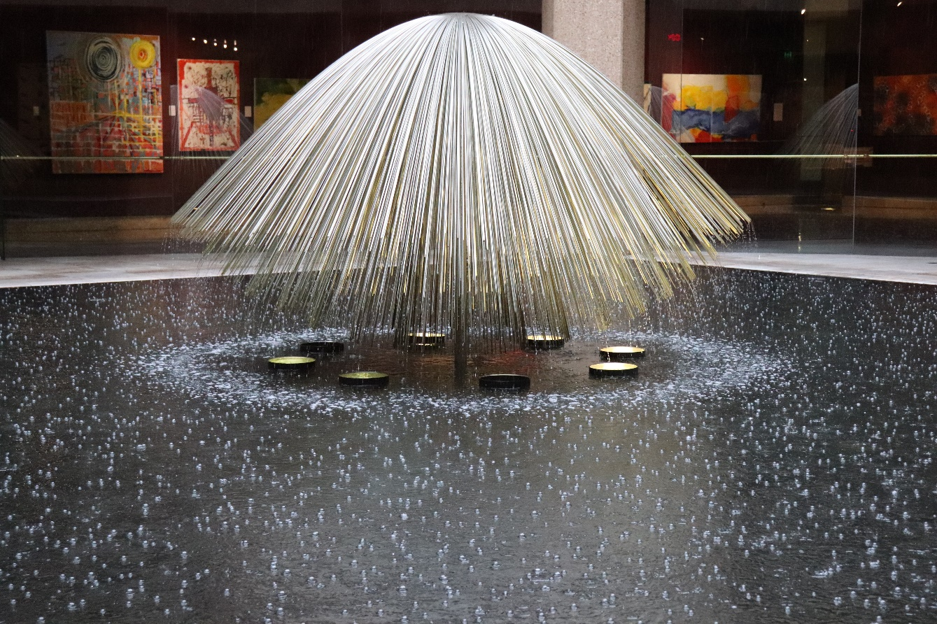
Outline
Background
Development
Structure
Next Steps

Slide 4
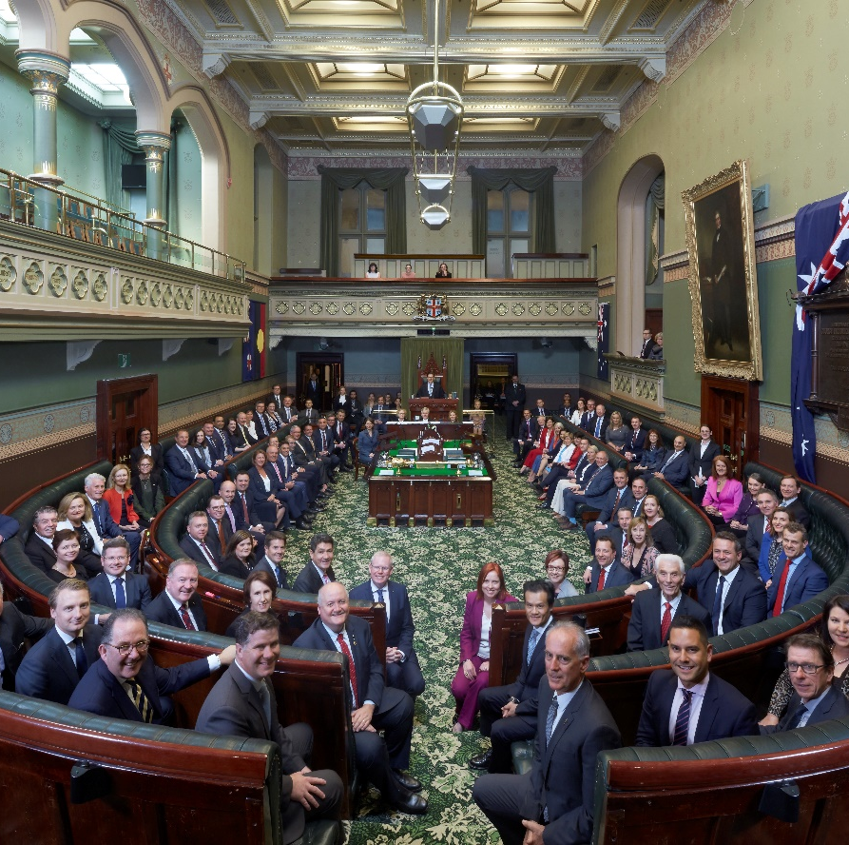
Background
Why have training, development and support mechanisms for MPs been lacking?
Employment structure
Threat of media criticism
Busy nature of the role
Cultural forces
Personality traits
At the same time, public trust in democracies and our public institutions has been declining.

Slide 5
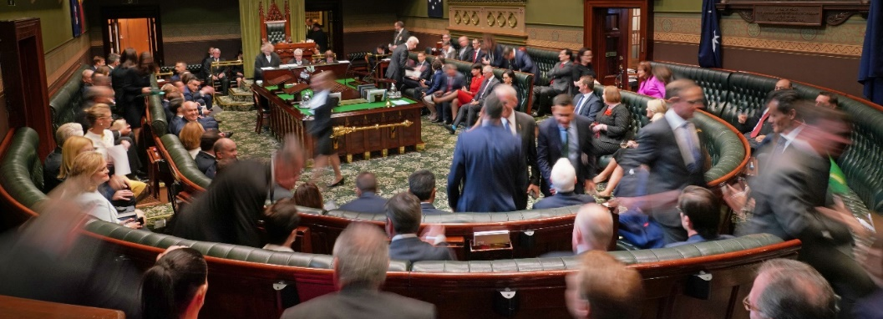
Development
How to introduce a Professional Development Program for Members?
Realise it takes time
Work out who your champions and influencers are
Involve politicians in the development phase – communicate why should they be involved and build internal and external support

Slide 6
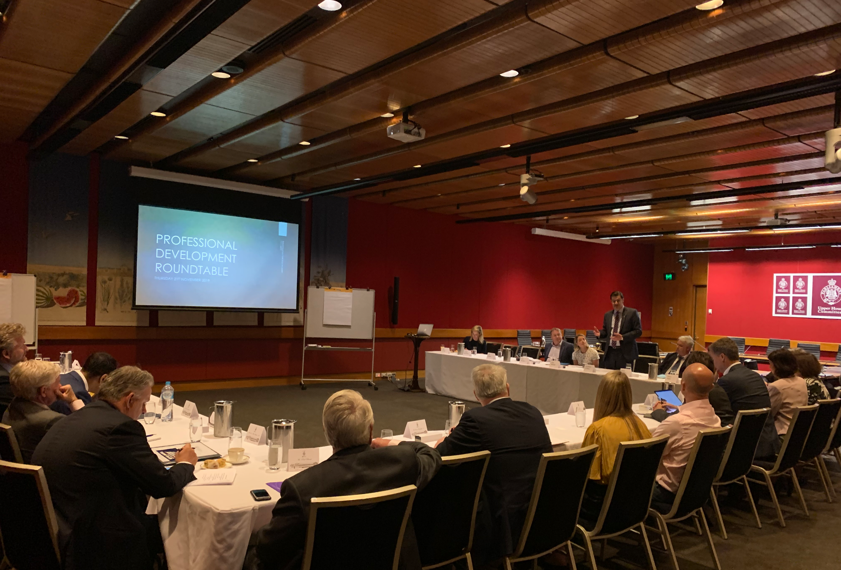
The Development Process
Preliminary Meetings with Key Stakeholders
Roundtable
Professional Development Working Group
Internal briefing

Slide 7
The Development Process
Glossy Brochure
Targeted Mass Media Coverage

Slide 8
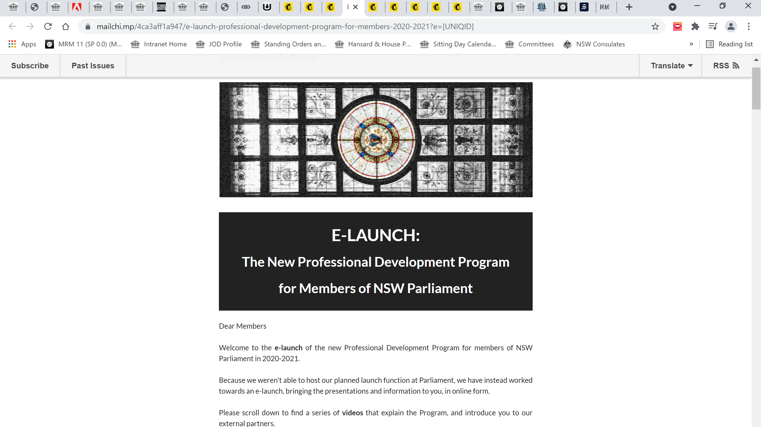
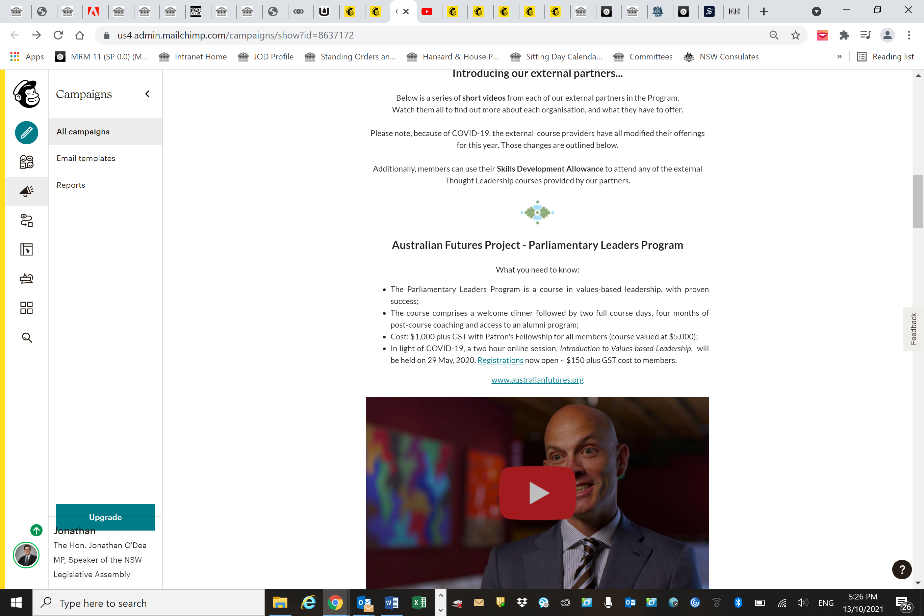
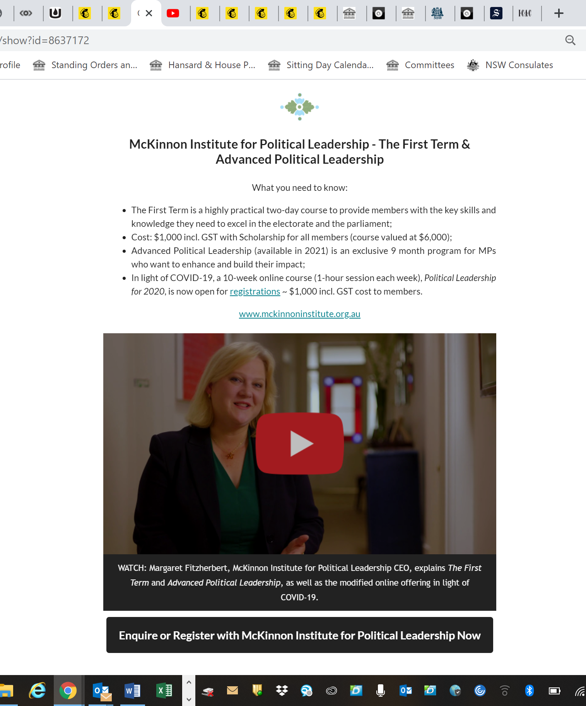
E-Launch
The Development Process

Slide 9
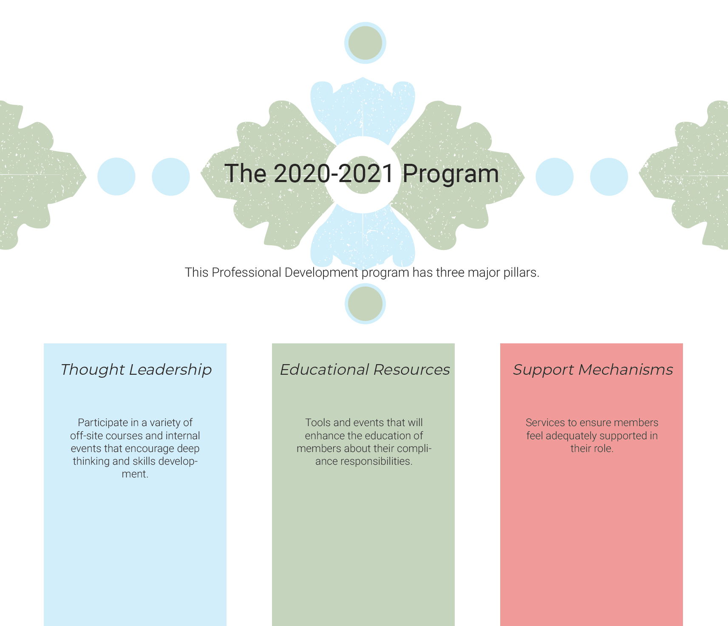
Structure
Key Pillars:
Thought Leadership
Educational Resources
Support Mechanisms

Slide 10
Thought Leadership events
External Partners Courses
Skills Development Allowance
On average, 20 MPs attended each course

Slide 11
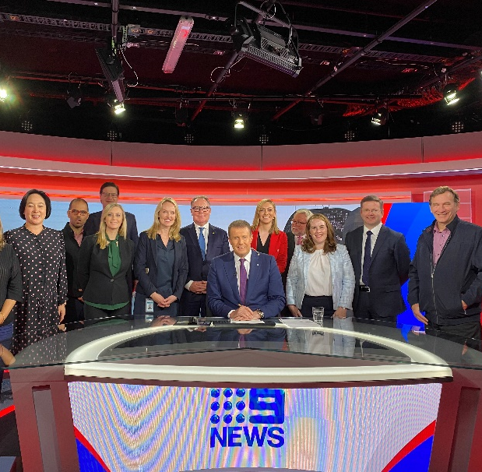
Educational Resources
Existing education offerings
Media Tours
Micro-learning via smart phone app (EdApp)

Slide 12
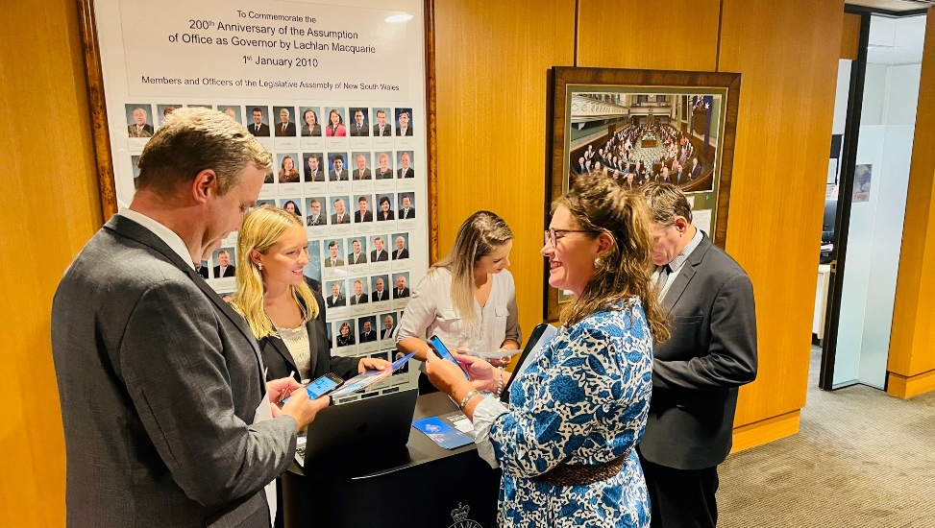
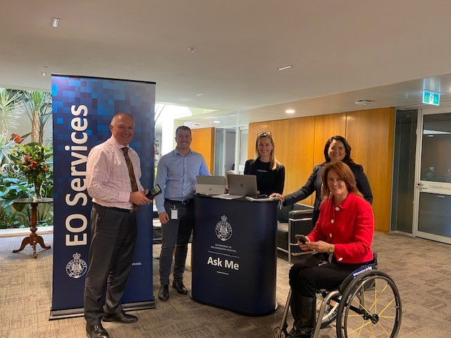
Educational Resources
Micro-learning via smart phone app (EdApp)
77 downloads and 18 completed the courses

Slide 13
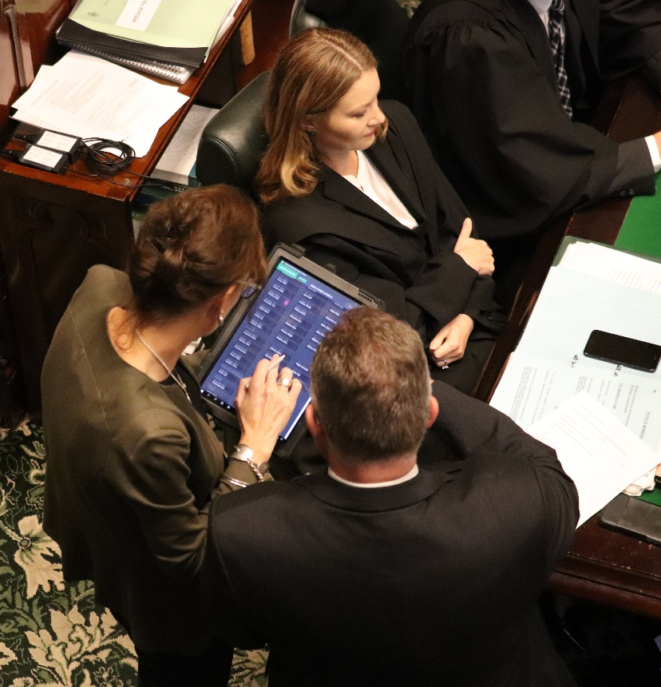
Support Mechanisms
Clerks
Ethi-Call
Parliamentary Ethics Adviser

Slide 14
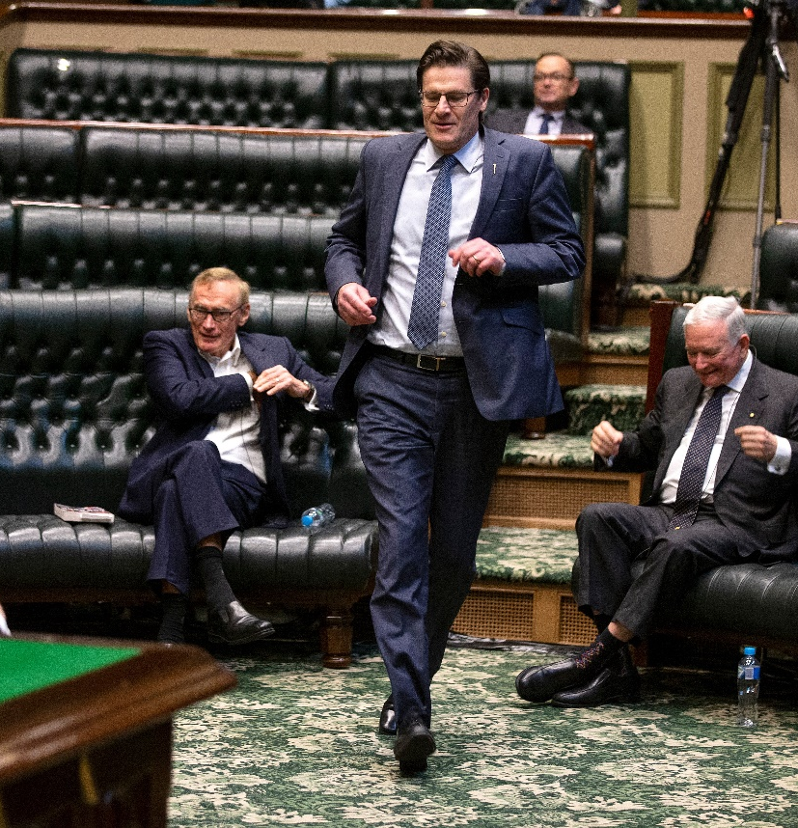
Next Steps
Partnerships
CPA Parliamentary Academy
Embedding in NSW Parliament
Driving cultural change
Ministers
Members
Staff
Focus on staff

Slide 15
BLANK SLIDE

Slide 16
BUILDING PARLIAMENTARY CAPACITY through Professional Development

Slide 17
McGill University: 200 Years of History
1821 Founded from a generous bequest by James McGill
39,267 Students from 150 countries
1,806 Faculty (Tenured & tenure-stream) from 70 countries
300,000 Alumni in 185 countries
146 Rhodes Scholars
3 Prime Ministers

Slide 18
School of Continuing Studies:
50+ Years of Teaching Adults
1853 First extension courses
1968 Center for Continuing Education launched
40+ Programs of study
6,500+ Adult learners per year
300+ Expert instructors

Slide 19
Our Parliamentary Programs & Academic Research
Professional Development Certificate in Parliamentary Management for Parliamentary Staff
Professional Development Certificate in Parliamentary Governance for Members of Parliament
10 + years of experience in parliamentary PD
Over 500 graduates from 50+ countries
Research on various aspects of parliamentary oversight funded by Canada’s SSHRC, British Academy and WFD

Slide 20
Parliamentary Management Program:
5 courses

Slide 21
Parliamentary Governance Program:
4 courses

Slide 22
Key Program Features
Designed for busy adults
Moderated by international experts
100% Online or Blended with a 1-week residential course at McGill
Combine theory and practice
Official university transcript – all courses are graded
Professional Development Certificate from McGill University
Affordable – CPA members enjoy preferential rates

Slide 23
Informed by Academic Research & program participants
Focus on good practices, future challenges and practical solutions
Comparative approach, but with focus on national application
What Makes These Programs Unique?

Slide 24
Awards:
Professional Development Certificate in Parliamentary Governance
2018 Best Custom Program Award at the Conference on Management and Executive Development (CMED)
2019 Program Award Winner at the Conference of the Canadian Association for University Continuing Education (CAUCE)

Slide 25
Retrospective Study Highlights:
2012 - 2022
100 Survey Respondents
34 Countries in all 9 regions
93% Shared their learning with colleagues
85% Applied their learning to their work in parliament
37% Changed their positions in parliament
69% Remained in contact with other participants

Slide 26
Testimonial
“ …No matter how thoroughly you may feel you understand the workings of a parliamentary assembly, participating in the study programme at McGill University…fosters greater insight and enables an appreciation of the value of good governance and the need to balance Executive power with parliamentary scrutiny.”
Hon. Daphne Caine, MHK
Isle of Man
Source: The Parliamentarian # 1, 2019

Slide 27
Recent Research Highlights
Beyond Westminster: A Global Perspective on Parliamentary Governance and Accounts
Anti-Corruption Evidence: Demand and Supply Sides of Corruption
The Role of Parliament in Curbing Corruption
Parliamentary Oversight in Small States
Expanded African Parliamentary Index
Parliamentary Oversight Handbook
Parliamentary Oversight and the Explosion of (COVID-Related) Government Spending and Debt
Gender Equality Handbook for Parliamentarians

Slide 28
www.mcgill.ca/scs-parliament

Slide 29
BLANK SLIDE

Slide 31
CPA Parliamentary Academy

Slide 32
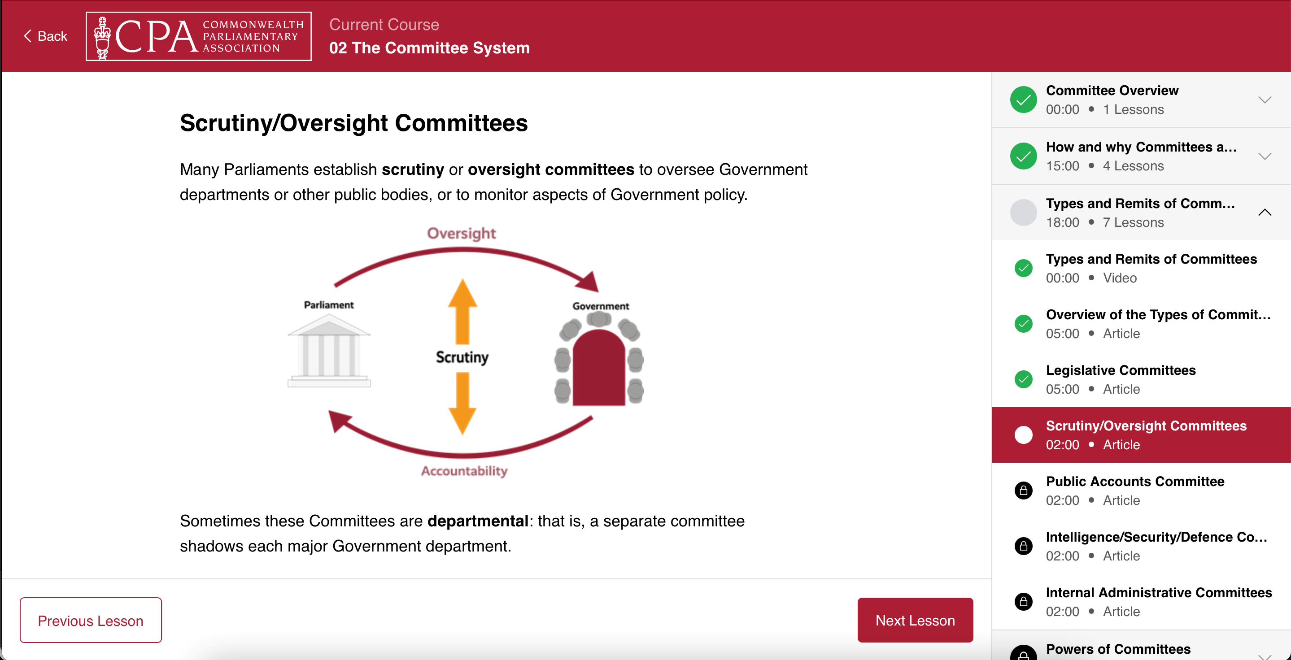
CPA Parliamentary Academy

Slide 33
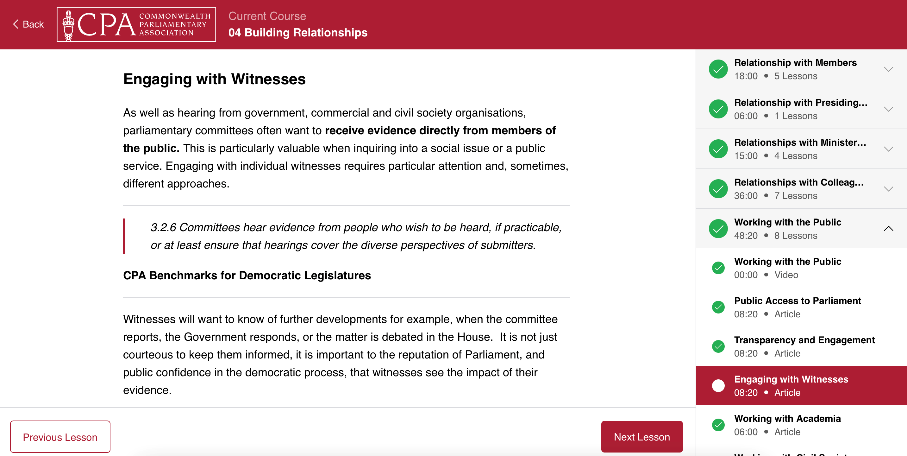
CPA Parliamentary Academy

Slide 34
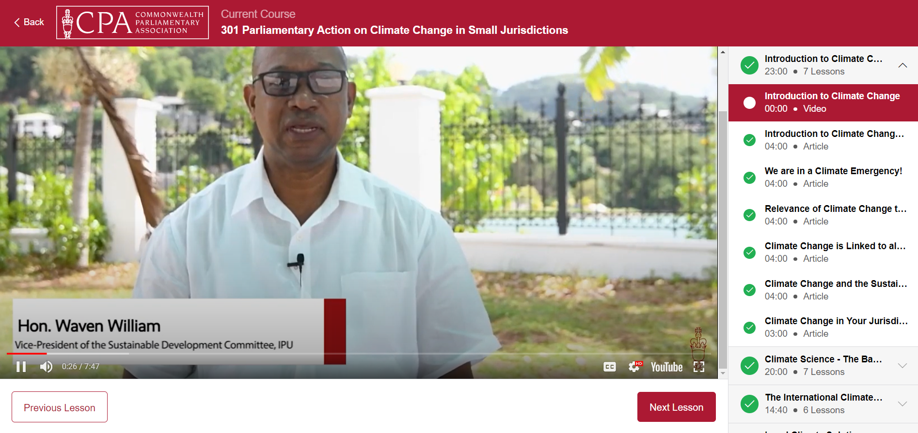
CPA Parliamentary Academy

Slide 35
CPA Parliamentary Academy – Available Course
CPA Parliamentary Professional Development Certificate
Induction for New Parliamentarians
Legislative Process
Scrutiny, Accountability and Oversight
Representation, Advocacy and Education
CPA Parliamentary Service Professional Development Certificate
Basic Principles of Parliamentary Procedure
Committee System
Administration and Management of Parliaments
Building Relationships
Strategy, Business Planning and Monitoring and Evaluation

Slide 36
CPA Parliamentary Academy – Courses in Development
CPA Networks
Small Branches – Climate Change Action
CPwD – Making Parliaments Accessible
CWP – Effective Women Parliamentary Caucuses
CPA Additional Courses
Public Accounts Committee Course (in collaboration with CPA UK)
Speakers and Presiding Officers Course
Committee Chairs Course
Sustainable Development Goals
https://youtu.be/lL_tuf85zNs

Slide 37
Thank you
Commonwealth Parliamentary Association (CPA)
lydia.buchanan@cpahq.org |www.cpahq.org

