Slide 1
CYC Introduction
The Commonwealth Youth Council (CYC) is the official representative voice of the more than 1.4 billion young people in the Commonwealth.
The CYC was first established in 2013 with the support of the Commonwealth Secretariat’s Commonwealth Youth Programme.
It was endorsed by Commonwealth Heads of Government at their biennial summit in Sri Lanka as an ‘autonomous, youth-led organisation’.

Slide 2
What do we do
CYC aims to further advance the youth development agenda by integrating young people into the development work of the Commonwealth at national, regional, and Pan-Commonwealth levels.
It also provides a sustainable platform for unified engagement with decision-makers and youth-led development initiatives.
The CYC works to mobilise the voices of young people and advocate for governments to engage young people meaningfully.
It partners with the Commonwealth Secretariat and other youth-led organisations focusing on youth development.

Slide 3
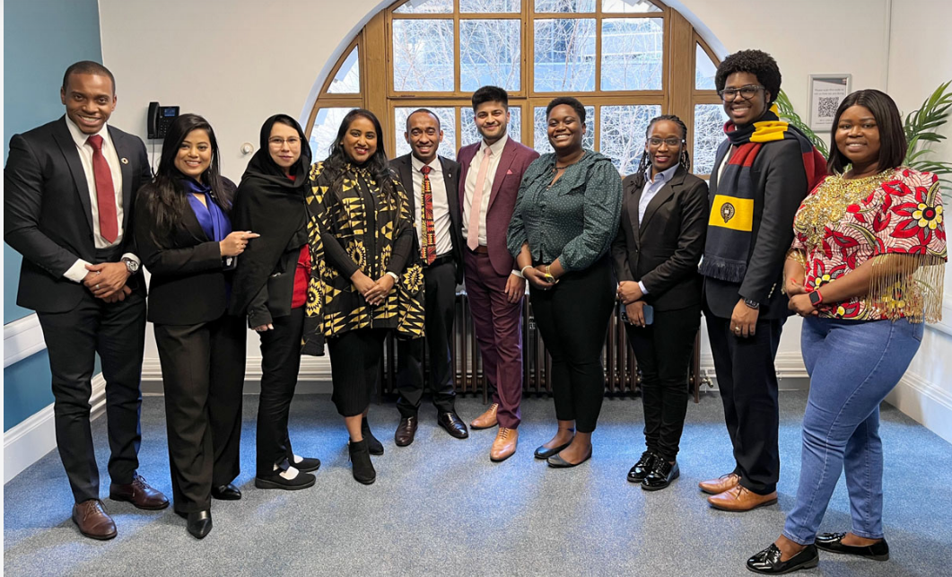
Our Team
Led by a ten-member executive, the CYC acts as a coalition of national youth councils and other youth-led civil society and private sector bodies from across the 56 member countries of the Commonwealth.
The current CYC Executives are as follows:
Chairperson: Mr. Kim Allen (Papua New Guinea)
Vice-Chair: Policy and Advocacy: Mr. Nahjae Nunes (Jamaica)
Vice Chair: Partnership and Resources: Mr. Everton Rattray (Jamaica)
Vice Chair: Inclusion and Engagement: Ms. Christabel Derby (Ghana)
Asia Representative: Ms. Fahmida Faiza (Bangladesh)
Africa Representative: Ms. Shamim Nabuuma (Uganda)
Caribbean Representative: Mr. Dominique Noralez (Belize)
Europe and Canada Representative: Mr. Namir Chowdhury (United Kingdom)
Pacific Representative: Ms. Sagufta Janif (Fiji)
Special Interest Groups Representative: Ms. Sania Haider Shikoh (Pakistan)

Slide 4
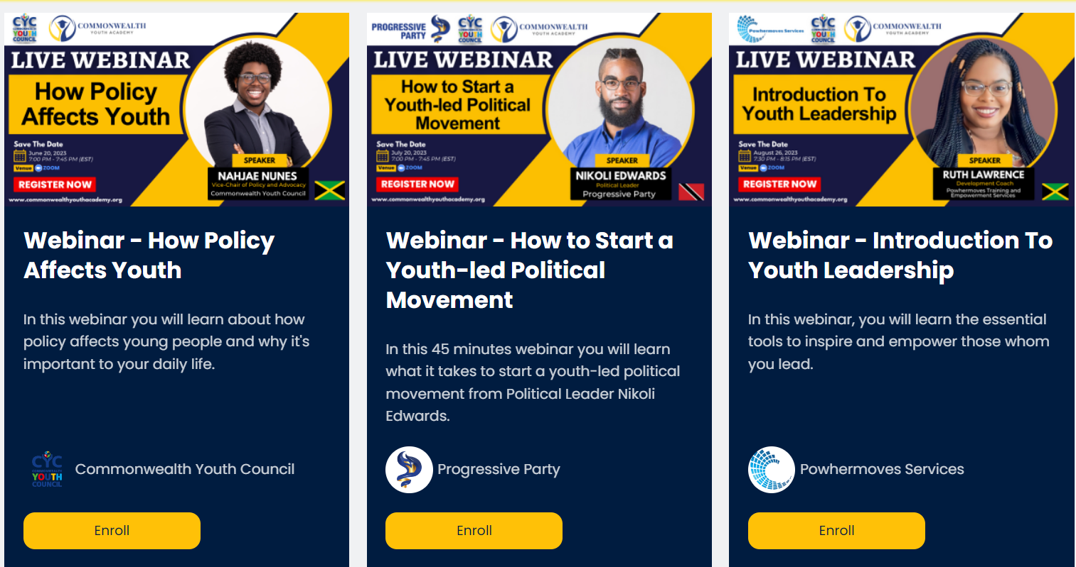
Commonwealth Youth Academy
The Commonwealth Youth Academy is an international organization working to tackle the issues of access to learning for youth in the commonwealth.
Our mission is to Educate, Connect & Empower 100 Million people over the next 5 years with the necessary knowledge, skills and access to opportunities that will help them to thrive in todays society.
Notes:
Practical skills, soft skills and digital skills

Slide 5
Positives of SDGs from Youth Standpoint
Awareness and Empowerment
The SDGs have raised awareness among youth about critical global issues, empowering them to actively engage in creating positive change.
01
Collaboration and Inclusion
The SDGs encourage youth to collaborate with diverse stakeholders, fostering a sense of inclusion and shared responsibility for sustainable development.
02
Youth Engagement
The SDGs provide a platform for youth to voice their concerns, ideas, and solutions, allowing them to contribute directly to policy discussions.
03
Education and Skill Development
The SDGs promote education on sustainable practices, enabling youth to acquire skills that align with future job markets and drive innovation.
04

Slide 6
Negatives of SDGs from Youth Standpoint
Limited Implementation
Many governments lack effective strategies to integrate SDGs into policy and legislation, resulting in slow progress on key goals.
01
Disconnected policies
Existing policies may not align with all SDGs, leading to inconsistencies and hindrances in achieving comprehensive sustainable development.
02
Lack of Youth Involvement
Despite recognizing youth as key stakeholders, governments often fail to include them in decision-making processes related to SDGs.
03
Insufficient Resources
Adequate funding and resources are necessary to drive SDG-related projects, and youth often face challenges in accessing such resources.
04

Slide 7
To further integrate SDGs into policy and legislation, parliamentarians and governments should consider the following steps:
Youth Participation Involve youth in the formulation and implementation of policies related to SDGs, ensuring their perspectives are adequately represented.
Education and Awareness
Incorporate SDGs into educational curricula, fostering a deeper understanding of sustainable practices from an early age.
Incentives and Accountability
Offer incentives for businesses and organizations that contribute to SDGs while establishing mechanisms to hold them accountable for their actions.
Funding Allocation
Allocate budgetary resources to initiatives aligned with SDGs, supporting youth-led projects and programs that address specific goals.
Cross-Sectoral Collaboration
Encourage collaboration across sectors, including government, academia, businesses, media

Slide 8
Envisioning the SDGs Beyond 2030
Integration and Alignment: Further integration of SDGs into national and international policies, serving as a foundation for addressing emerging challenges and evolving global realities.
Innovation and Technology: Rapid technological advancements impacting SDG pursuit, accelerating progress through innovations like renewable energy, AI, and biotechnology.
Digital Divide: Bridging digital gaps for digital inclusion, closing access, education, and skills disparities through the digital transformation.
Youth and Education: Empowering youth through education, skill development, and engagement, fostering youth-led initiatives and innovative approaches to education.
Continued Commitment: The vision shaped by global trends, evolving priorities, and collective commitment of nations to create a more sustainable and prosperous world for current and future generations.

