Slide 1
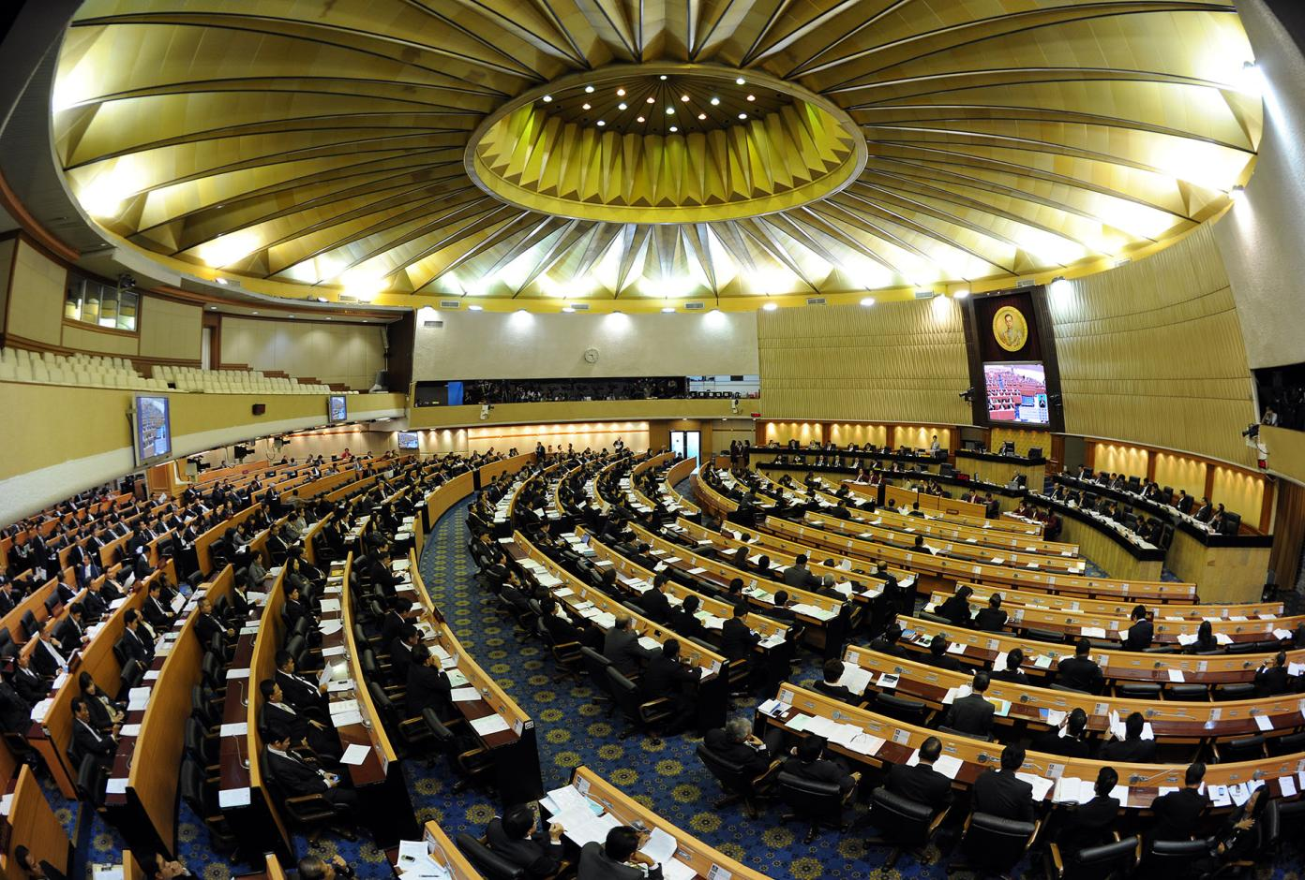
The Role of Parliaments in Implementing the SDGs
Ricardo Godinho Gomes
Chief Technical Advisor, UNDP
August 2023

Slide 2
Overview
Where we are with the SDGs and Agenda 2030
The Role of Parliaments in the Implementation of the SDGs
UNDP Work with Parliaments to Advance the SDGs
A Few Lessons looking beyond the 2030 Agenda…

Slide 3
Notes:
Agenda 2030 and its SDGs are a global shared commitment.
It remains our overarching roadmap for achieving sustainable development and overcoming the multiple crises the world is facing.
But the Agenda is a promise, not a guarantee. Now, halfway to the 2030 deadline, it is clear that promise is in deep peril with the favourable trends resulting from early efforts, particularly in extreme poverty, gender equality, global unemployment, proving now to be too fragile and too slow.
The SDGs are in deep peril.
The world has changed profoundly since the first SDG Summit in 2019 and since the adoption of the 2030 Agenda in 2015.
Out of the roughly 140 targets for which data is available shows that only about 12 per cent are on track; more than half, although showing some progress, are moderately or severely off track; and some 30 per cent have either seen no movement or regressed below the 2015 baseline.
Going to the next SDG Summit scheduled for upcoming September, the word in everybody’s mind is CAUTION!!! Not enough evidence and data; the limited data collected shows stagnation or even regression in most targets; World governments migth be now less inclined for consensus on the SDG commitments due to geopolitics.
But, decades of experience has shown us that investing in development is the best route out of crisis and strengthening governance systems will accelerate progress towards all the SDGs.

Slide 4
Parliaments and the SDGs
YOUTH
INNOVATION SUMMIT
Sweden2020
Notes:
Parliaments are an important actor on the implementation of the SDGs. They are key for drafting the legislation needed for incorporating the SDGs into national legislation. They are key in overseeing the implementation of the government of the SDGs as well as approving and overseeing that the SDGs get the budget their need. Parliaments are also key for ensuring that marginalized groups needs and views are represented in the SDG legislation.
The United Nations General Assembly recognized this again in December 2022, when it adopted a resolution entitled Enhancing the role of parliaments in accelerating the achievement of the Sustainable Development Goals
Yet, parliamentary engagement in the SDGs leaves much to be desired. Despite some good examples of parliamentary activism, political buy-in is generally weak and important institutional challenges remain. In many parliaments, the SDGs continue to be perceived as a “foreign” agenda that has little to do with domestic priorities. Capacities for oversight and legislation are limited or under-utilized, laws and budgets are not in sync with national development plans, women, youth and vulnerable groups are under-represented, and individual SDGs are still dealt with in silos.
On the more positive side, parliaments that have proper SDGs coordination structures (committees or caucuses) are doing better in their legislative and oversight roles even though, generally, such structures are lacking in authority and resources. A few parliaments are working pro-actively monitoring the SDG implementation domestically and working across borders with other parliaments to share best practices.
Overall, parliamentary engagement in the government-led Voluntary National Reviews remains weak, though a growing number of parliaments are providing input into the reviews.

Slide 5
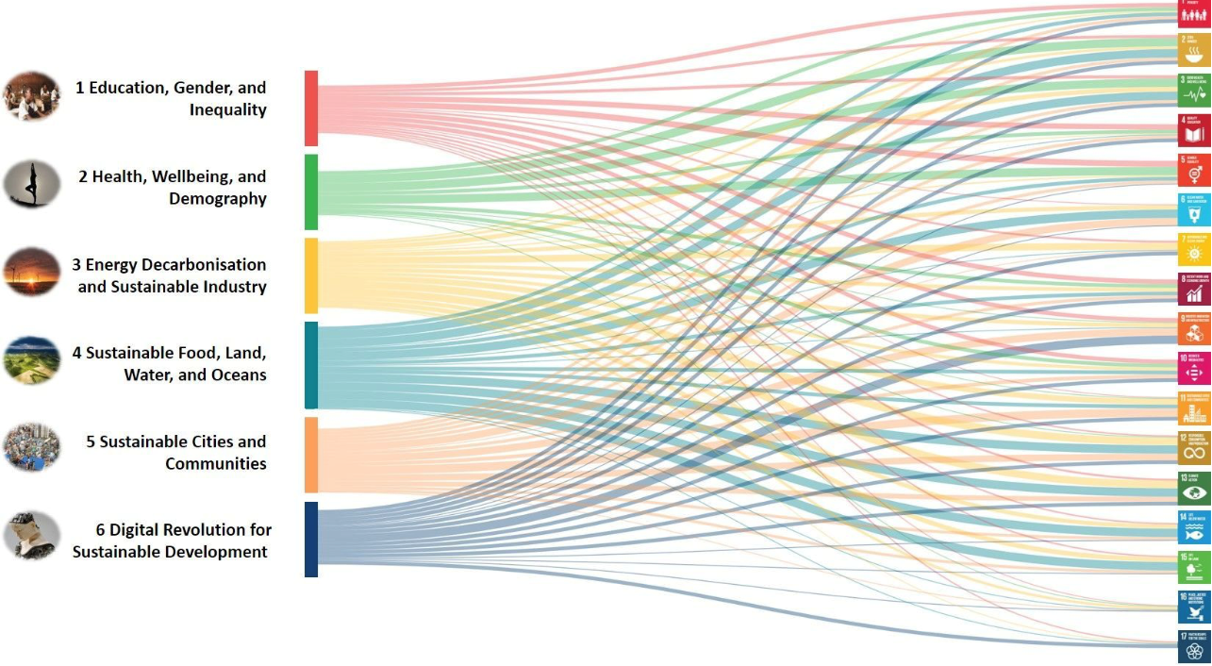
How complex can it be for parliaments & MPs to contribute for Agenda 2030 and the operationalization of the SDG targets?
Sachs, J.D., G. Schmidt-Traub, M. Mazzucato, D. Messner, N. Nakicenovic, and J. Rockström (2019),
“Six Transformations to Achieve the Sustainable Development Goals”, Nature Sustainability. DOI: 10.1038/s41893-019-0352-9
YOUTH
INNOVATION SUMMIT
Sweden2020
Notes:
The Sustainable Development Goals (SDGs) and the Paris Agreement on Climate Change call for deep transformations in every country that require complementary actions by governments, parliaments, civil society, science, business, etc.
Yet stakeholders lack a shared understanding of how the 17 SDGs can be operationalised. These Transformations are linked with priority investments and regulatory challenges calling for actions by well-defined parts of government working with business and civil society.
How can parliaments navigate this complexity bringing their big political guns to the table for enabling the 2030 Agenda and the operationalization of its SDGs?

Slide 6
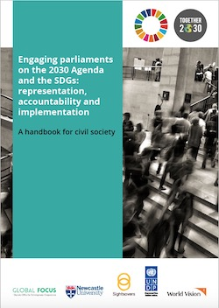
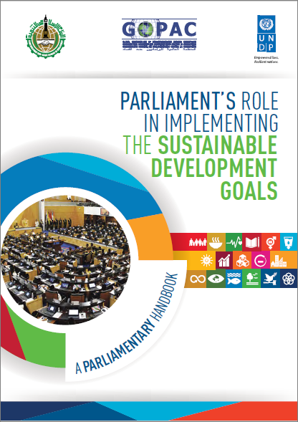
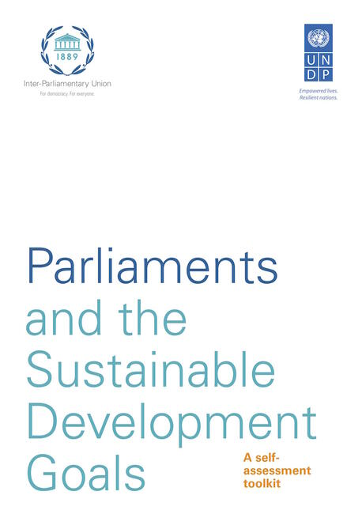
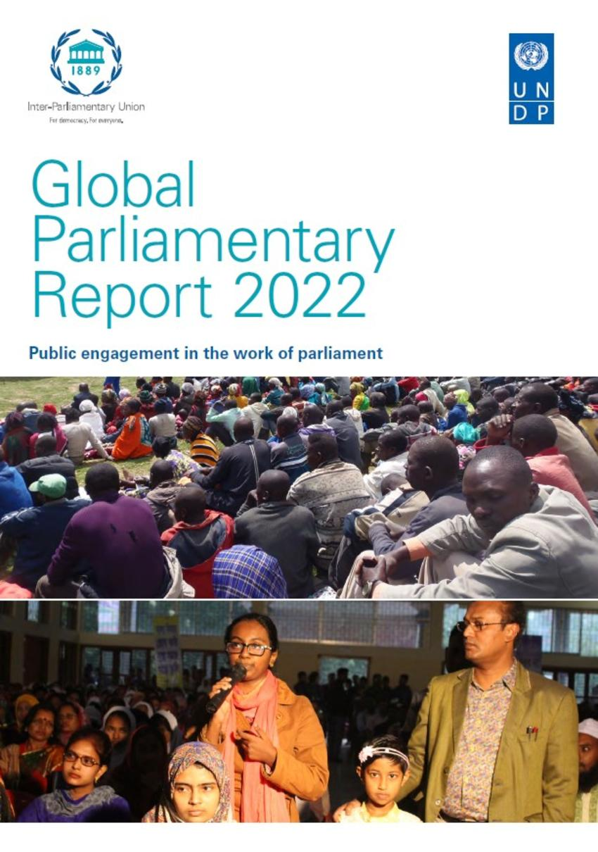
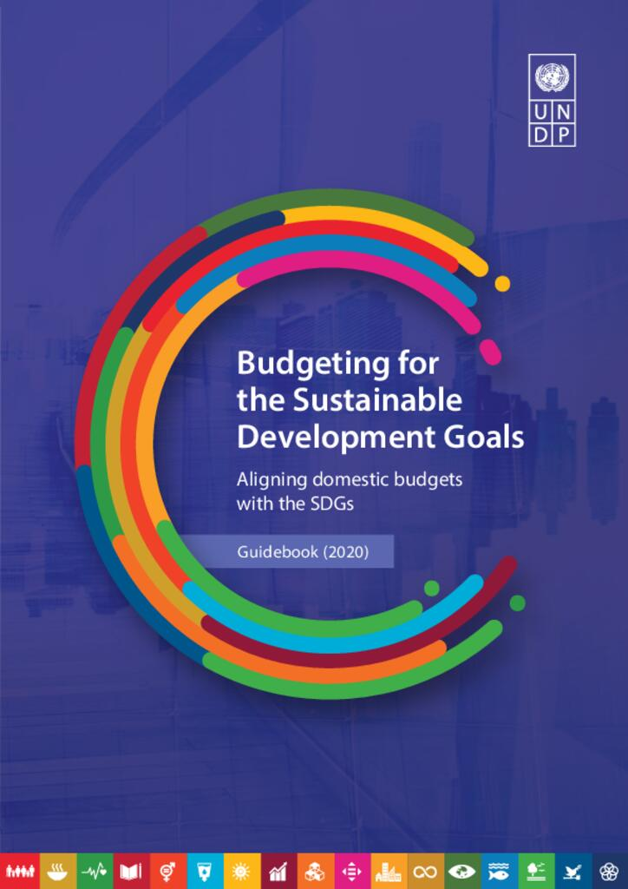
UNDP’s Work with Parliaments
UNDP works to strengthen parliamentary bodies by:
boosting efforts to reform and improve parliaments and local assemblies, making them more representative, open, and accountable;
delivering training and building skills among parliamentarians and their secretariats on legislative and budget scrutiny, gender equality, and international human rights obligations, and critical sustainable development issues that parliaments need to act on;
enhancing parliamentary transparency, using new technologies, tools, and capacities in data, budgeting, and finance; and
Brokering partnerships between parliaments and other relevant state and non-state governance actors – e.g., SAI and CSOs.
Notes:
UNDP works with parliaments around the world to strengthen their capacities to fulfill their institutional responsibilities and to work more effectively as part of a system of partners, including with national ministries, local governments, independent oversight bodies, and civil society. This support helps ensure that elections, national planning, budgeting, and law-making efforts are more inclusive, gender-responsive, and risk-informed. More specifically, UNDP works to strengthen parliamentary bodies by:
boosting efforts to reform and improve parliaments and local assemblies, making them more representative, open, and accountable;
delivering training and building skills among parliamentarians and their secretariats on legislative scrutiny, gender equality, and international human rights obligations, and critical sustainable development issues that parliaments need to act on;
enhancing parliamentary transparency, using new technologies, tools, and capacities in data, budgeting, and finance; and
Brokering partnerships between parliaments and other relevant state and non-state governance actors – e.g., SAI and CSOs.
UNDP can support parliaments and parliamentarians in their legislative, oversight, and representative functions. UNDP can provide technical assistance, training, and knowledge-sharing platforms to strengthen parliamentary institutions and help legislators effectively contribute to national development agendas and also advance in climate action. UNDP together with other partners foster dialogue and cooperation among parliaments, as well as civil society and supreme audit institutions to advance the sustainable development goals.
UNDP has developed significant knowledge and tools to increase the capacity of parliaments to implement the SDGs.

Slide 7
The UNDP EU-funded multi-country programme for consolidating Economic Governance & PFMS in the 6 PALOP-TL countries has been building partnerships among state and non-state PFM actors since 2014
These partnerships are operationalised through multi-stakeholder CoPs and multi-country parliamentary high-level working groups involving MPs and parliamentary staff, SAI auditors and technical staff, Government officials (MoF and Planning)
Focus on SDGs 5, 16 & 17

Slide 8
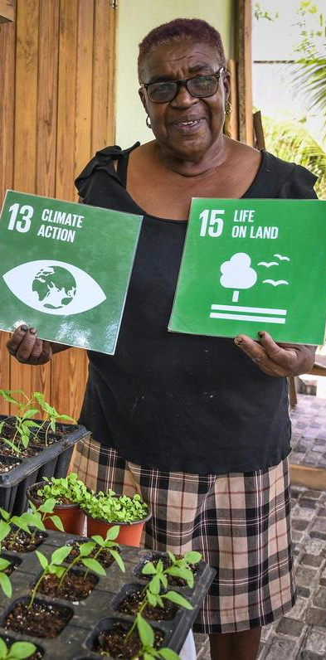
Traditionally-delivered democratic governance – including parliamentary accountability – is critical, but on its own insufficient to address the intersecting global confidence, planetary, poverty and inequality crises. Apart from institutional strengthening, our programmes support parliaments to form more constructive and systematic partnerships with executive governments, civil society, independent oversight bodies, and new and old media. Governance systems that result from such partnerships are demonstrably more inclusive; leading to more effective oversight of how services are delivered; and to laws and budgets that look beyond the interests of the elites.
Example: The Pro PALOP-TL SAI Programme empowers parliaments, government ministries, independent oversight bodies and civil society on a systemic basis for more open, transparent and accountable public finance management in all six Portuguese-speaking African countries and Timor-Leste. This whole-of-society model has proven to boost the overall governance transparency and openness - key ingredients to build democratic accountability and trust. In Angola, Cabo Verde and Sao Tome and Principe, making the budgets more gender-responsive – with parliamentary processes as an entry point – has given teeth to gender equality policies.
Notes:
Example: One of our oldest and largest EU-funded projects, Pro PALOP-TL, empowers parliaments, government ministries, independent oversight bodies and civil society on a systemic basis for more open, transparent and accountable public finance management in all six Portuguese-speaking African countries and Timor-Leste. This whole-of-society model has proven to boost the overall governance transparency and openness - key ingredients to build democratic accountability and trust. Successfully delivered on a SST basis for 10 years, the approach will now be leveraged for a more sustained approach to open government in other country contexts in partnership with the European Parliament. In Angola, Cabo Verde and Sao Tome and Principe, making the budgets more gender-responsive – with parliamentary processes as an entry point – has given teeth to gender equality policies.

Slide 9
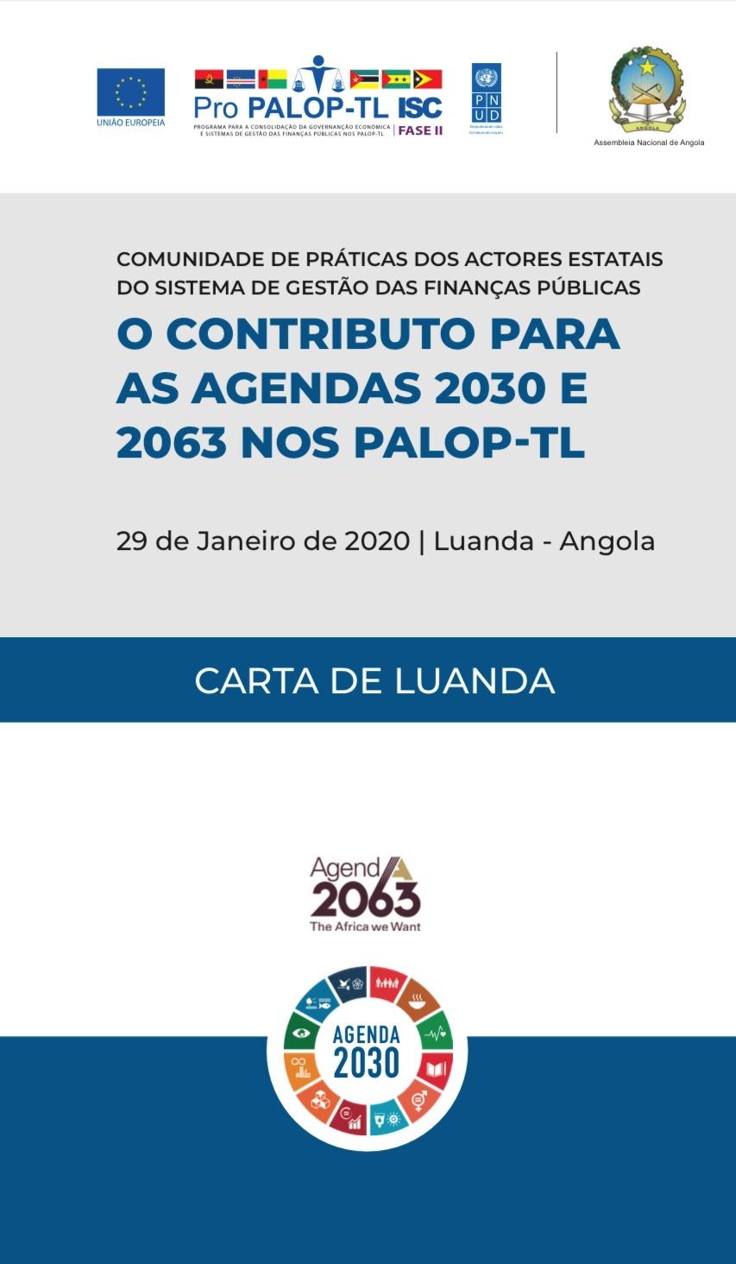
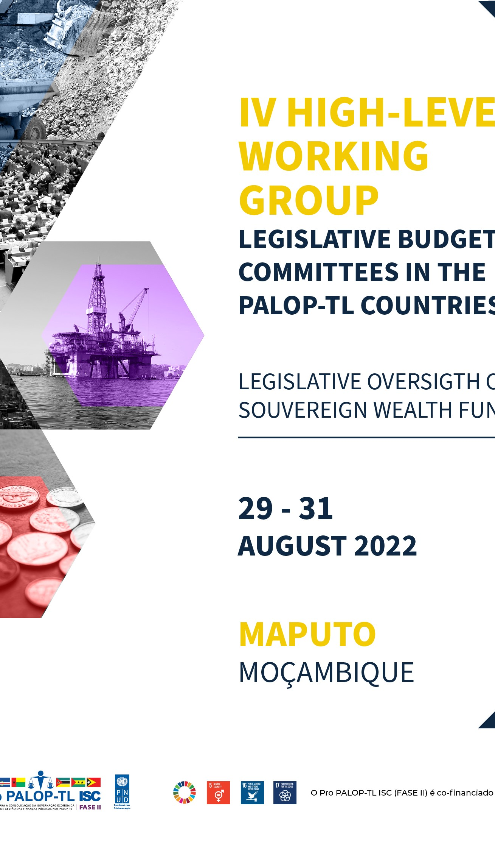
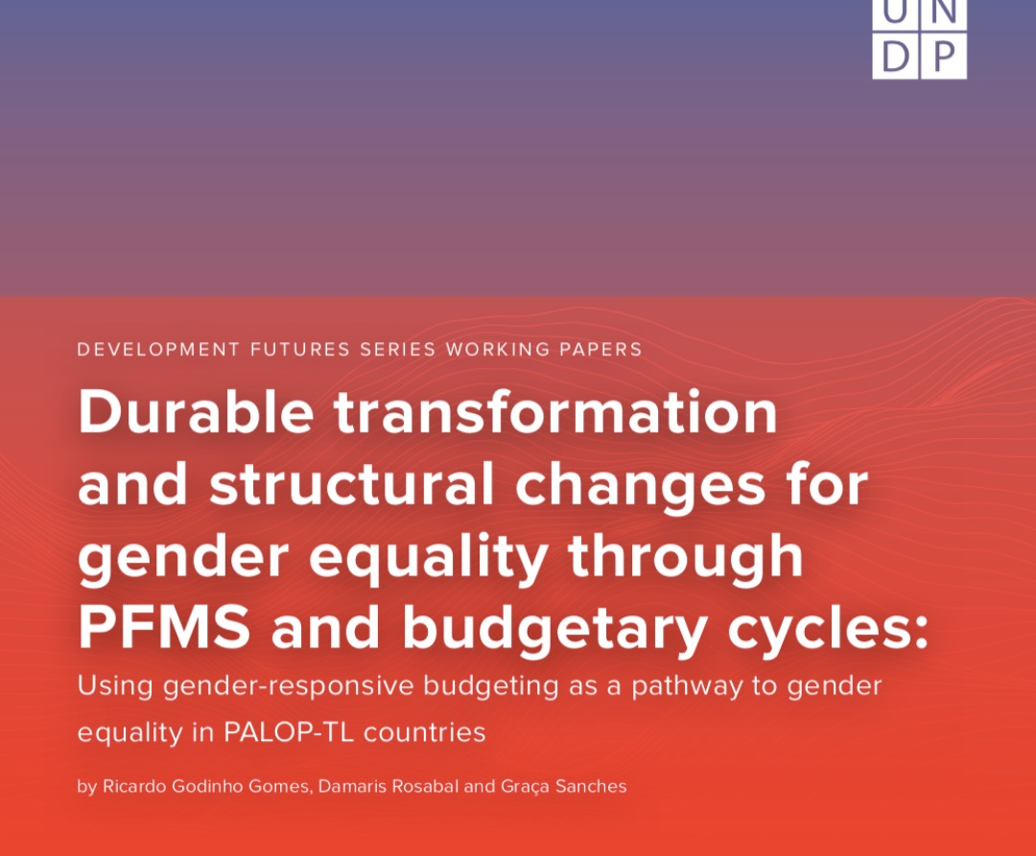
Notes:
A couple of examples of the way UNDP is supporting parliaments to build partnerships with other relevant actors in PFMS, such as the executive, SAI and civil society (including academia) as an enabler of its capacity to ensure effective oversight of public expenditure and sources of public revenue in a VUCA world.
In January 2020, just 4 months after the 2019 SDG Summit, a multi-stakeholder and multi-country CoP gathered 140 delegates in Luanda, Angolan Parliament, to discuss the contributions of parliaments, supreme audit institutions and ministries of finances of the 6 PALOP-TL countries to accelerate the delivery of SDG national targets in their respective countries through coordinated strategies and policies. 3 set of recommendations were agreed by the representatives of parliaments, SAI and MoF addressing for government, SAI and parliaments with suggested course of action.
In August 2022, a High-Level Working Group of Legislative Budget Committees gathered 64 MPs and parliamentary staffers from the 6 PALOP-TL countries in Maputo, Mozambique, to discuss with SWF executive managers, international experts, practitioners, and representatives of central banks and MoFs on the challenges for parliaments to ensure oversight of these huge sources revenue with potential to trigger economic development. Maputo Charter sets out the commitments assumed by the delegates to enhance oversight of such complex instruments in ways that benefit the SDGs.
In April 2023, representative of PALOP-TL parliaments join high-profile public officials from national governments (ministries of finances and senior PFM advisors) and international organisations, heads of supreme audit institutions, civil society activists, and academics in a public finance international forum to assess SDG 16 progress in the PALOP-TL countries and how to reform PFMS in ways that contribute for building inclusive and strong institutions.
In June 2023, UNDP Global Policy Network included the PALOP-TL countries’ experience in promoting gender through a all-of-government approach with parliaments at its center, as part of the 2023-2025 gender equality strategy. The experience and lessons learnt were captured in a policy brief and working paper and published in the UNDP Global Library.

Slide 10
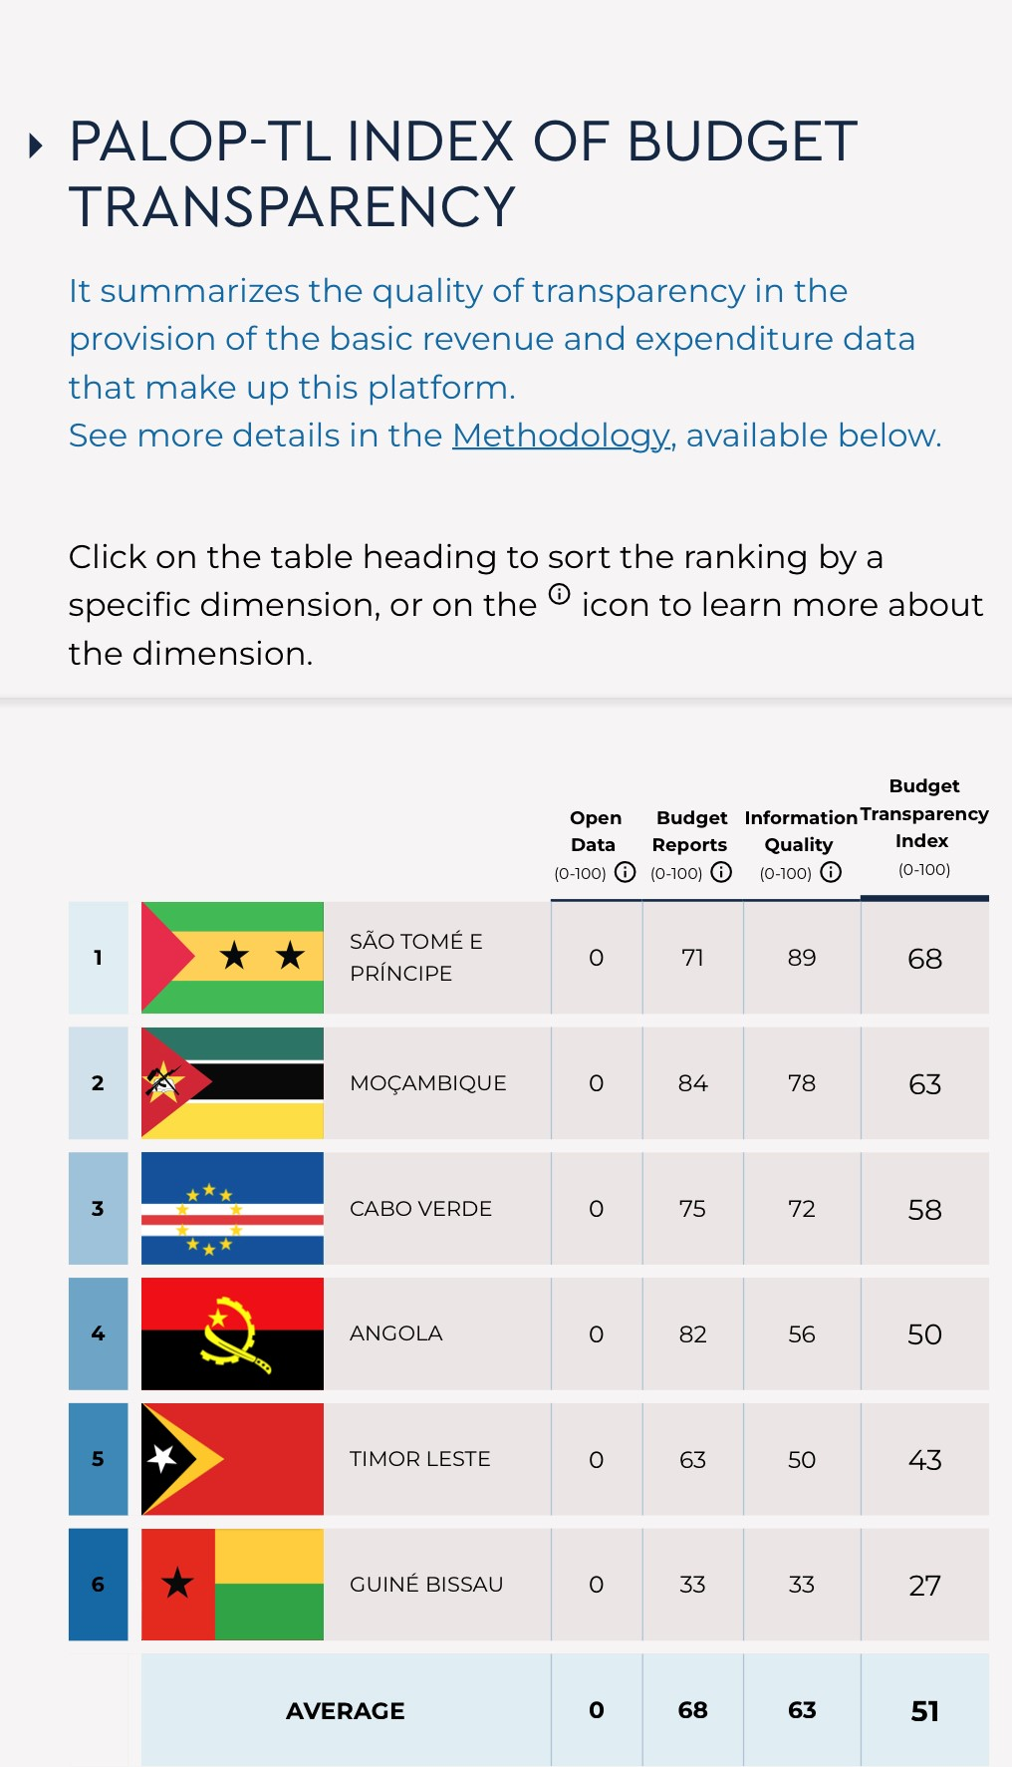
Notes:
In August 2023, the multi-country PALOP-TL eBudget CSO Digital Platform for transparency & accountability was published by OECD as a case study of Public Sector Innovation. The platform is an intersection for civil society, parliaments, SAI and other PFM external control actors to access simplified, open and interactive fiscal data with the aim to support oversight on the executive actions.

Slide 11
A Few Lessons …
Parliaments that have proper SDGs coordination structures (committees or caucuses) overall are doing better in their legislative and oversight roles even though, generally, such structures are lacking in authority and resources. Partnerships and peer exchanges and learning can help the parliament in identifying best practices to monitor SDGs. Parliament involvement in National Voluntary Reviews essential.
Example: As part of a multi-partner initiative coordinated by IPU, UNDP developed a set of indicators measuring parliamentary fitness for purpose, based on Sustainable Development Goal 16, targets 16.6 and 16.7. The indicators captured parliamentary good practice on oversight of the 2030 Agenda; gender mainstreaming and gender responsive budgeting; human rights; parliamentary and inter-parliamentary cooperation; and oversight of the security sector, foreign affairs and international cooperation policy.
Notes:
There is a need to enhance the role of Parliaments in the implementation of the SDGs.
They are key for drafting the legislation needed for incorporating the SDGs into national legislation.
They are key in overseeing the government's performance on the SDGs as well as approving and overseeing that the SDGs get the budget they need.
Parliaments are also key for ensuring that marginalized groups' needs and views are represented in the SDG legislation.
Overall, parliaments with SDG coordination structures (committees and caucuses) are) are doing better in their legislative and oversight roles. Yet, many of these structures require capacity, authority, and resources.
Parliaments also need to be involved in government-led Voluntary National Reviews.

Slide 12
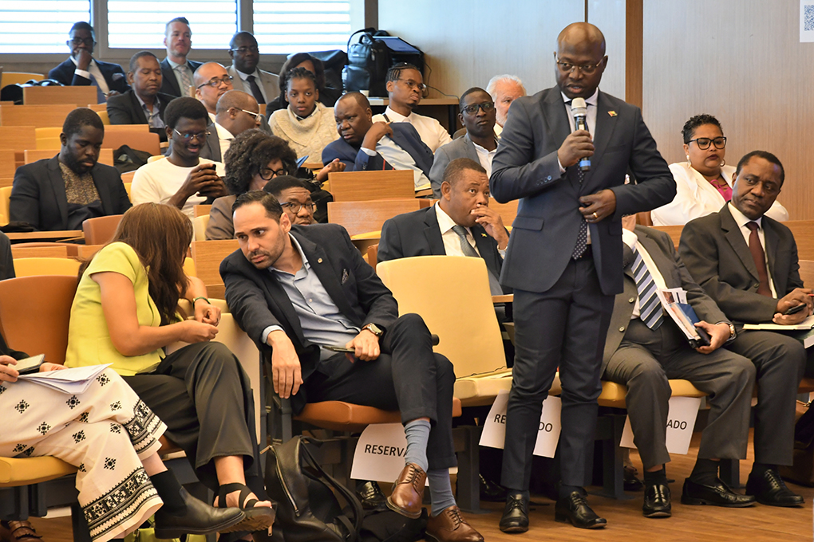
Looking beyond 2023…
Parliaments will continue to be the house of representatives of the public, they will never be think-tanks or research cabinets…
Legislation & oversight will continue to be subjected to the politics of representation…
Parliaments need to partner with other actors to ensure checks & balances in today’s VUCA world and navigate the complexity of operationalizing the SDGs…

Slide 13
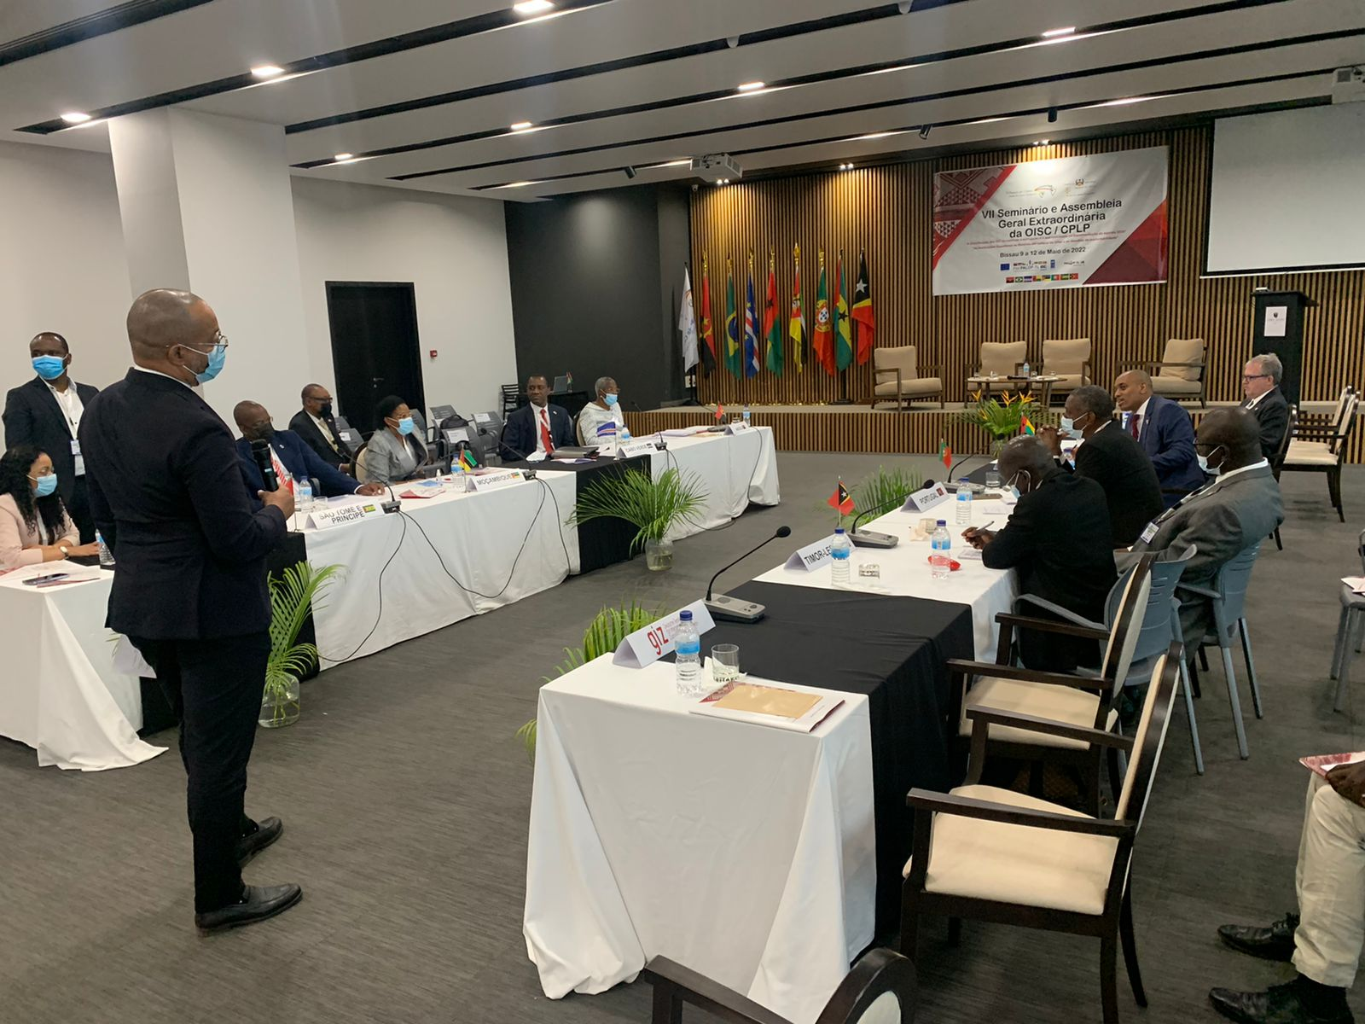
Looking beyond 2023…
The many transformations needed to accelerate the operationalization of SDGs will require increased DRM capacities and easy access to open, timely and accurate/granular data on sustainable development at local/national/regional/global levels.
Governments need to provide these services and parliaments need to be able to use them effectively.

Slide 14
Thank you

