Slide 1
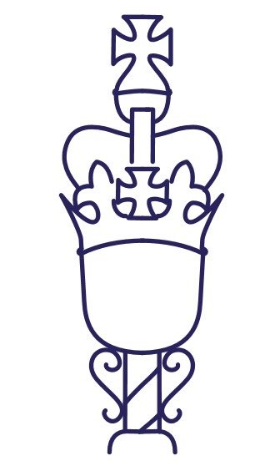
WORKSHOP F: Building Gender Sensitive

Slide 2
Gender Sensitizing Commonwealth Parliaments
Prof. Sarah Childs
University of Edinburgh
Sarah.childs@ed.ac.uk

Slide 3
Parliaments must work to become gender sensitive institutions…they must actively champion gender equality for all.
To do this they must first acknowledge that issues such as parliamentary cultures, governing structures, facilities and institutional resources have the capacity to limit the equal participation of women and other underrepresented genders. These obstacles can hinder a parliament’s ability to be an effective democratic institution

Slide 4
An International Norm and International Imperative
A GSP values and prioritises gender equality as a social, economic and political objective and reorients and transforms a parliament’s institutional culture, processes and practices, and outputs towards these objectives (Childs and Palmieri 2021)

Slide 5
Dimension 1 Equality of Participation within Parliament | How a diverse group of MPs might be selected for, and elected to, parliament and how, once present, they are enabled to become effective participants across parliament’s core activities: representation and interest articulation, legislative scrutiny, and executive accountability.
Dimension 2 Parliamentary Infrastructure | The way in which parliament facilitates the work of Members and whether this privileges a particular type of MP – explicitly or implicitly…from the buildings and furniture of parliament to the official rules and working practices that underpin the array of Members’ parliamentary activities.
Dimension 3 Parliamentary Culture | Acknowledges that the official, written-down rules never tell the whole story about how institutions function on the ground – this is what might be thought of as the ‘normal way of doing things’. It is, admittedly, frequently hard to pin down informal institutional norms, practices and culture. That said …parliamentary culture… is not fixed but an evolving phenomenon, subject to change.
Dimension 4 Gender Equality Policy/ Women’s substantive representation | Subjecting the political work of parliament to gendered analysis - legislation, policy, scrutiny and interest representation. It asks whether parliaments acknowledge the perspectives and address the needs and interests of women. Have women’s experiences been taken into account? Are the gendered differentiated outcomes to women’s disadvantage? Do they aim for gender equality between women and men? In so doing, such analysis will frequently be analysing a parliament’s work in holding a government to account for its gender sensitivity.

Slide 6
Institutionalization
Successful institutionalisation involves not only determining necessary reforms relevant to a particular Parliament and its circumstances but in identifying the actors and means through which reforms are implemented, and GSP Standards maintained.
The responsibility to re-gender Parliaments can no longer be left as an additional burden for women Parliamentarians, nor to willing women and men Parliamentarians; it is for the Parliament as an institution, both political and administrative.

Slide 7
CPW GSP Standards
CPA GSP 2020 Standards
Equal Representation | Parliamentary Infrastructure | Parliamentary Culture | Gender Equality Policy/Substantive Representation
Equal participation as candidates Diversity of women & men No motherhood gap Necessary resources No gender barriers Supply and demand side mechanisms Equal participation as elected members Shared leadership No horizontal/vertical segregation (pol or admin staff) Good parliamentarian ideal is diverse | Clear procedures, practices & norms Accessible rules & buildings Certainty of parliamentary scheduling Women’s parliamentary bodies Parent MP needs are met MPs well resourced Technology/hybridity Bespoke mental/physical health support - work/life balance GS Security, engagement & communications policies | 'truly representative, transparent, accessible, accountable and effective institution GS code of conduct; equalities training; VAW-P policies – independent grievance schemes Shared sense of institutional belonging Open and welcoming institution Diverse artwork | Institutional commitment to GSP Parliament seeks gender equal outcomes GSP mainstreamed & scrutinized Routine gender budgeting & GE impact assessment In house gender expertise Intersectional gender analysis Gender equal committees/bodies Committee witnesses are gender balanced/diverse Formal, routine and substantial links with women’s CSOs

Slide 8
CPA 2020 Checklist
Institutional leadership: Gender equality parlia bodies; balanced governing body; gender equality plan; institutional rules on partic; const law include GE
Data: Collection and publication of disaggregated data
Reviews: Ever/recent GSP audit/review been undertaken? Any GSP consultations? Needs of parent MP; sexual harassment/VAW prevalence/code of conduct
Gender Expertise: Presence and capacity of gender experts; training; legislative provision; links with extra-parlia women
Women’s Parliamentary Bodies: caucus, committee, or network; what GSP formal/informal role do they play; women’s legislative committee; funding support women MPs visit other parliaments

Slide 9
CPA 7 Steps (2022 Fieldguide)
Understanding Gender Sensitivity
Embracing Gender Sensitive Parliament Principles
Preparing a Team and Strategy
Performing Initial Diagnostics
Preparing the Review – Collecting Data
Reporting of Findings and Making Recommendations
Monitoring progress

Slide 10
Gender Sensitizing a Parliament: lessons of success & failure
Institutionalization Processes
Shared agenda for change
Gendered Parliamentarianism
Critical actors and (male) allies in positions of power
Necessary new Institutions: House/Speaker Advisory Group
Gender conscious administration
Supportive women’s civil society/media

Slide 11
RECOMMENDATION:
“Commonwealth national and sub-national legislatures should consider collaborating with male parliamentarians and parliamentary staff to successfully build gender sensitive parliaments.”

